Slide 1

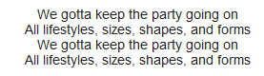
Smart Mobile: Android
Wk3.1: Styles, shapes and forms…
http://www.youtube.com/results?search_query=all+lifestyles+beastie&aq=0&oq=all+lifes

Slide 2
Goal
Show styling options.
→ Use for creating your own application

Slide 3
Outline
Styles - intro
Drawables: Shapes
D.R.Y. Styles
Data exchange between Activities (aka: Html::forms)
Drawable selectors (aka Css::onHover)
Tip:
ListView

Slide 4
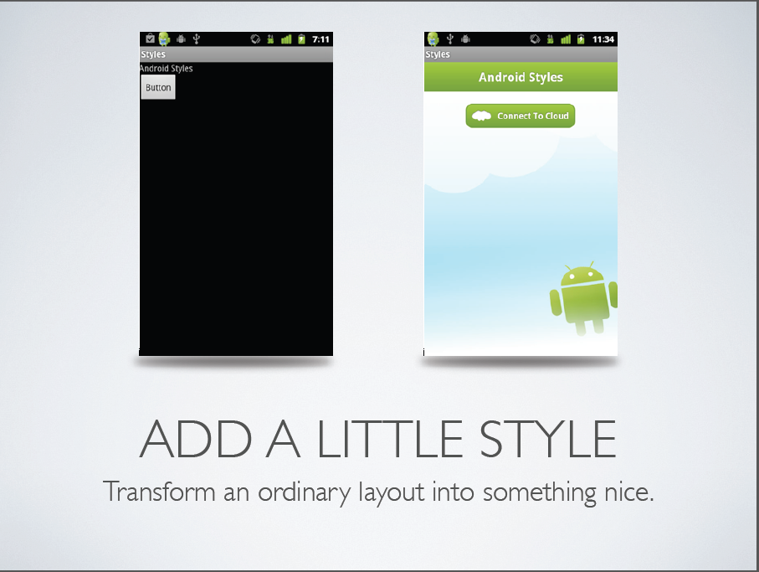
http://www.slideshare.net/androidalliance/android-styles

Slide 5
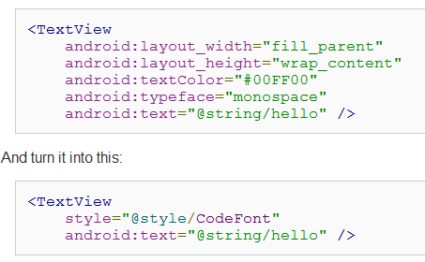
Separate Style from Layout
http://developer.android.com/guide/topics/ui/themes.html

Slide 6
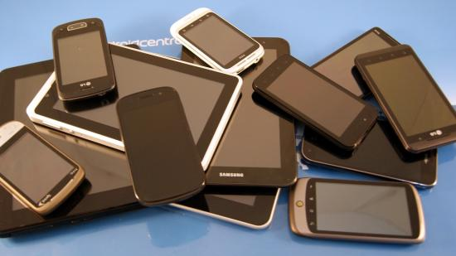
Optimize Style for each phone! Layout = unchanged!

Slide 7
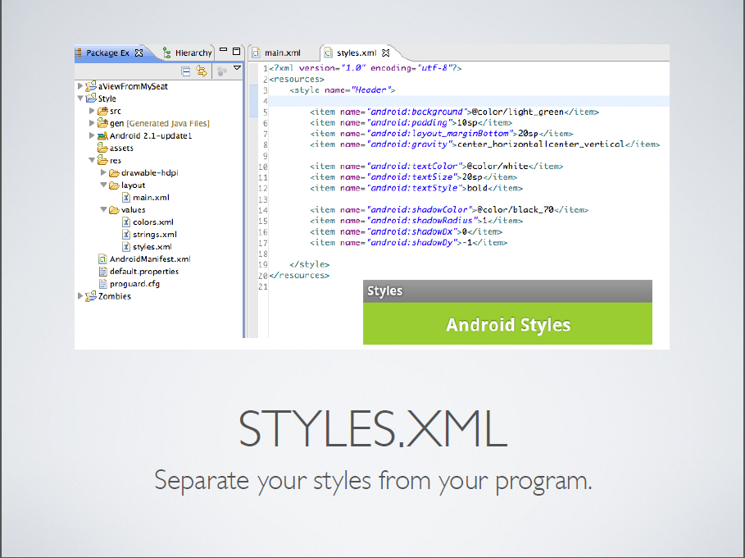
http://www.slideshare.net/androidalliance/android-styles

Slide 8
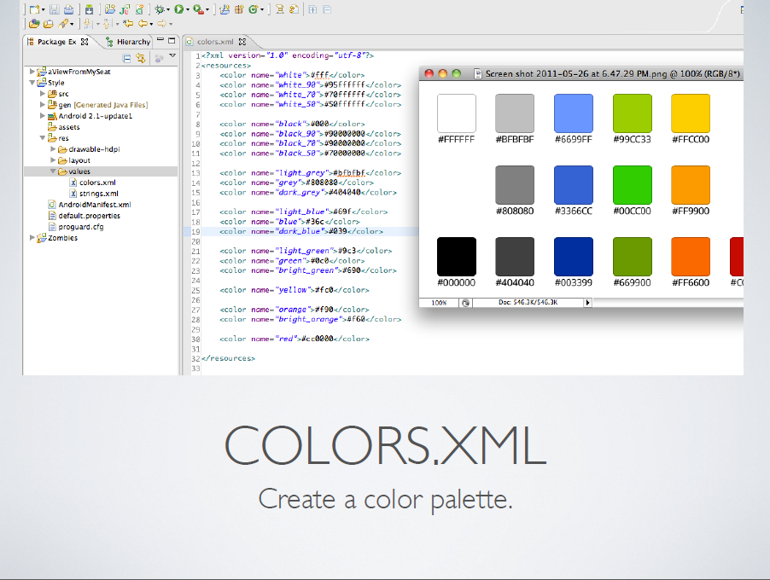
http://www.slideshare.net/androidalliance/android-styles

Slide 9
Separate Style from Layout
Header”
http://developer.android.com/guide/topics/ui/themes.html

Slide 10
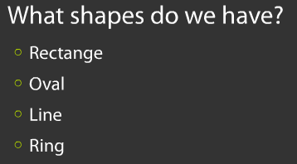
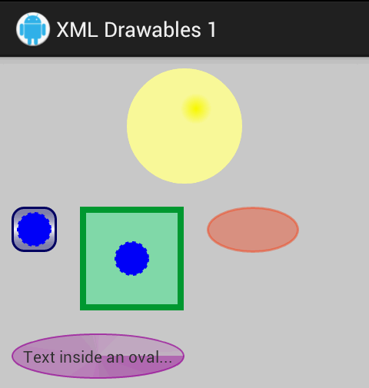
Drawable shapes?
Source
http://www.slideshare.net/pavelpetrek/google-developer-day-2010-prague-styles-in-android

Slide 11
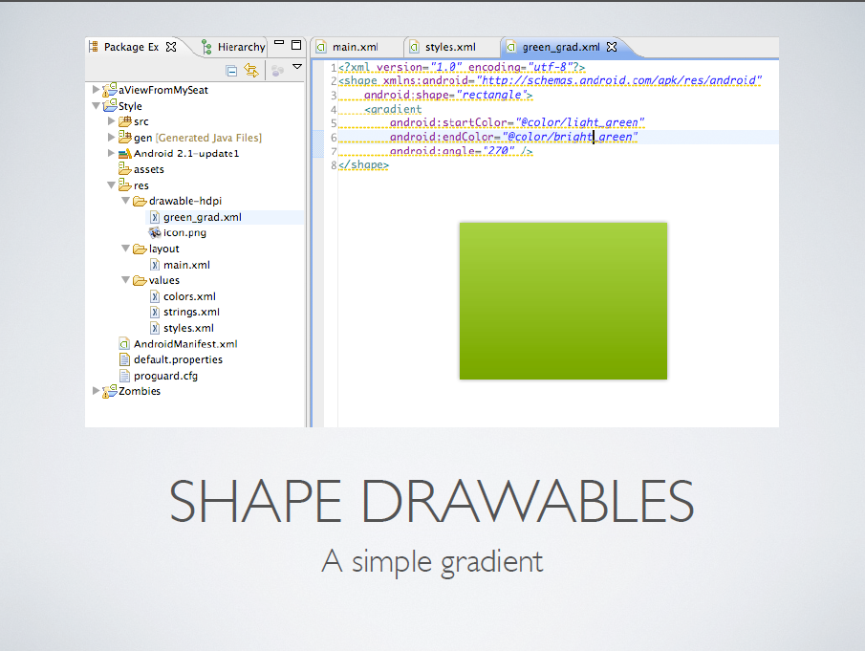
http://www.slideshare.net/androidalliance/android-styles

Slide 12
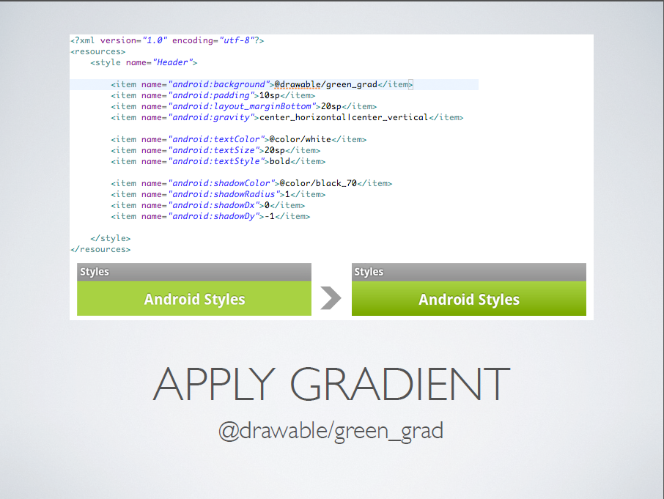
http://www.slideshare.net/androidalliance/android-styles

Slide 13
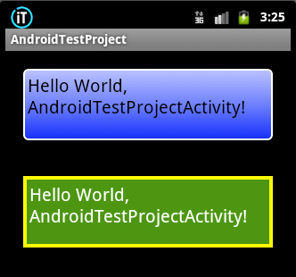
Shape elements:
<shape android:shape=“line|rectangle|oval…”>
<solid … />
<gradient …/>
<stroke … />
<corners …/>
</shape>
Source

Slide 14
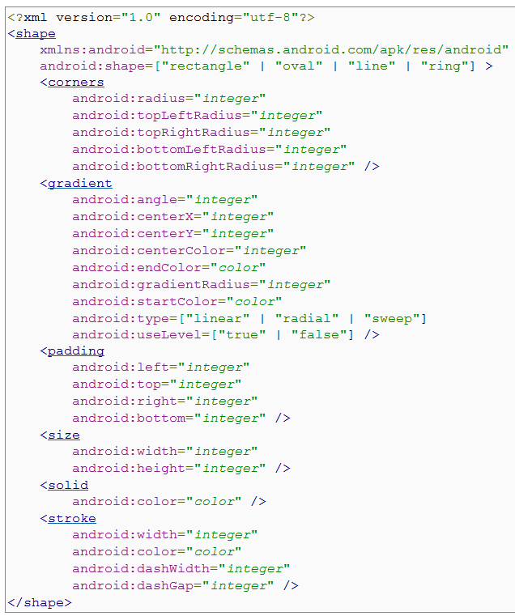
http://developer.android.com/guide/topics/resources/drawable-resource.html#Shape

Slide 15

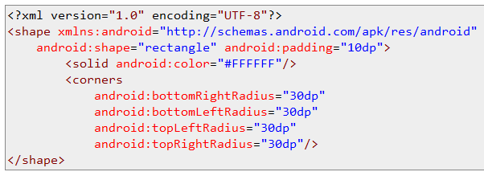
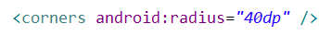

Shape with corners:
http://stackoverflow.com/questions/6105521/android-shape-corners-do-not-work-when-setting-individual-corners

Slide 16

Style hierarchy
Stay D.R.Y.

Slide 17
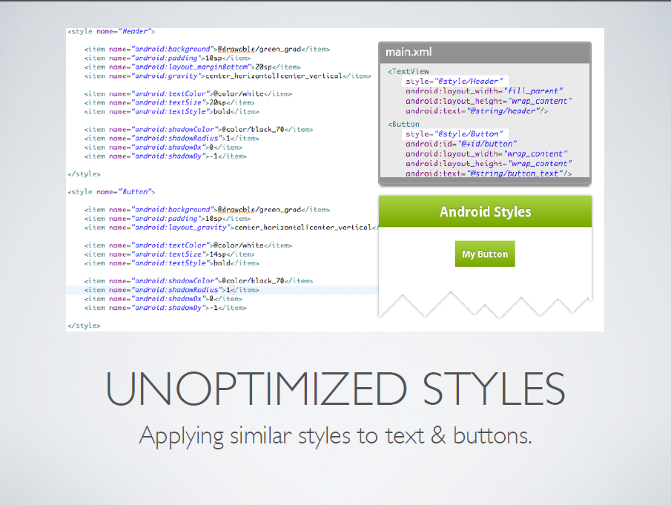
http://www.slideshare.net/androidalliance/android-styles

Slide 18
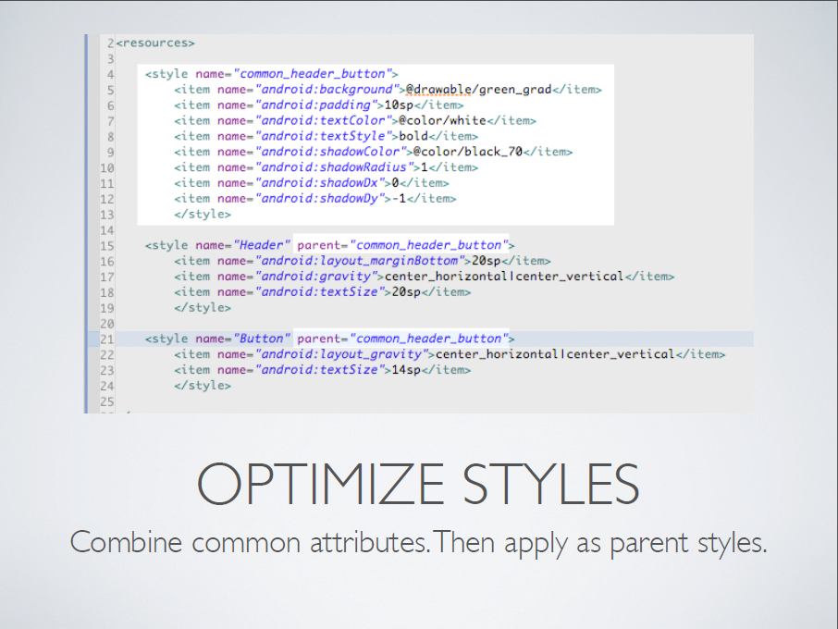

http://www.slideshare.net/androidalliance/android-styles

Slide 19
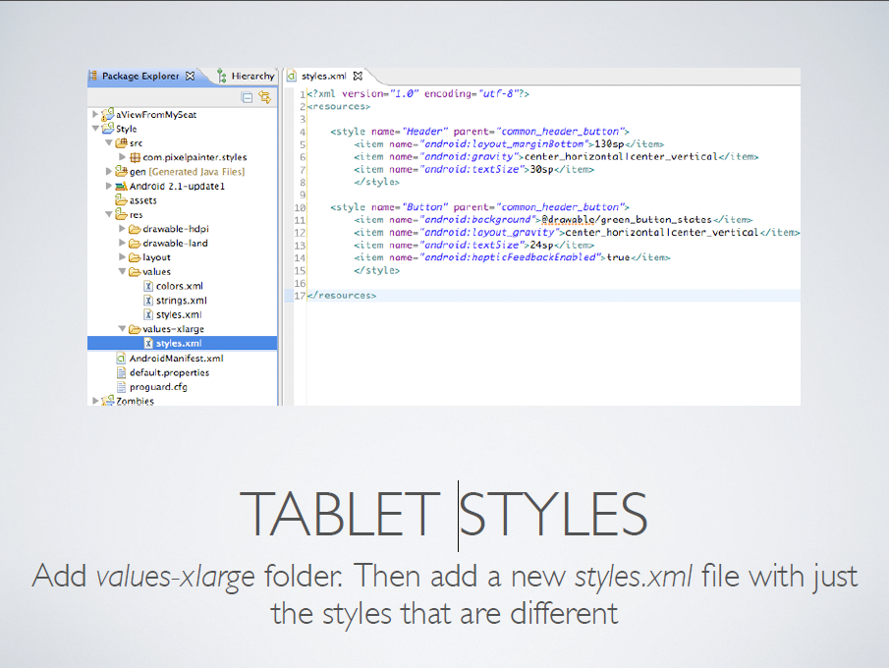
http://www.slideshare.net/androidalliance/android-styles

Slide 20
Outline
Styles - intro
Drawables: Shapes
D.R.Y. Styles
Data exchange between Activities (aka: Html::forms)
Drawable selectors (aka Css::onHover)
Tip:
ListView

Slide 21
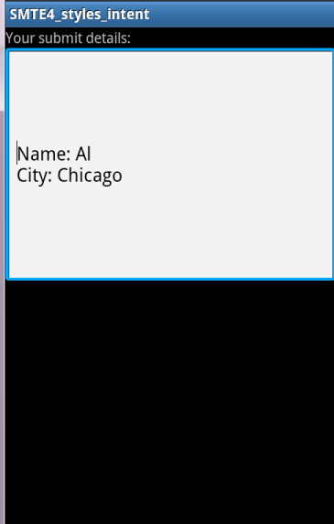
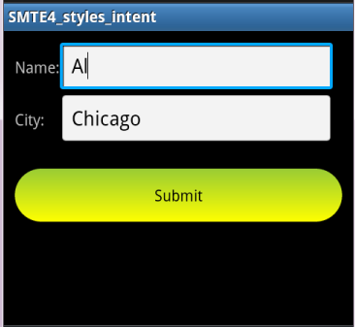
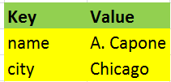

Data Exchange between Activities

Slide 22
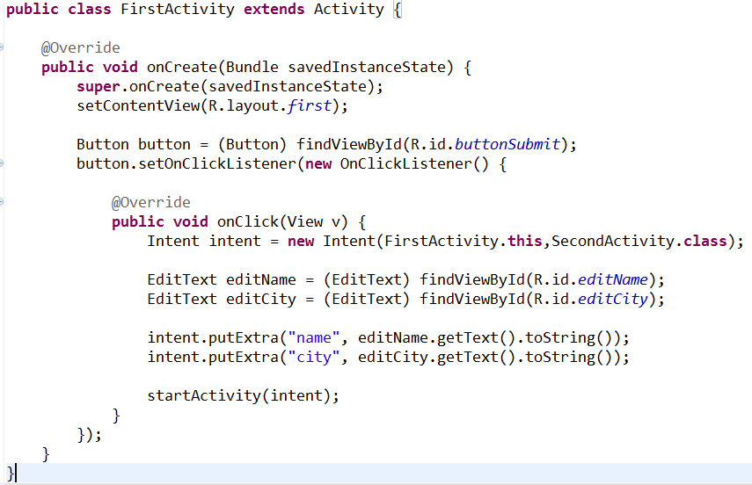
Intent code - send:
Map

Slide 23

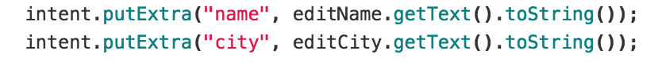

intent
“A. Capone”
name
Map
“Chicago”
city
A key can be seen as a label applied to some data item.

Slide 24
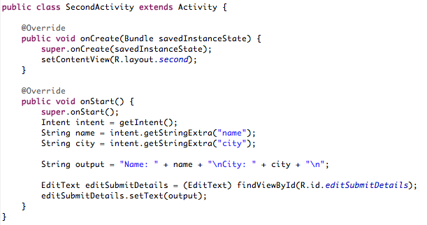
Intent code - retrieve:
Map

Slide 25
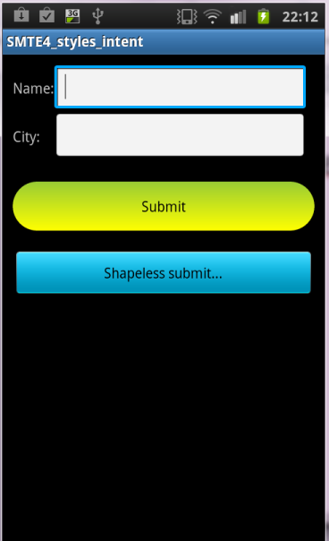
Shaped button looses the selection highlight….
Now what?

Slide 26
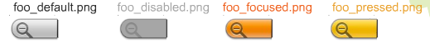
Button backgrounds
Button changes background when touched…
How to do this?
http://www.slideshare.net/AndroidDev/android-ui-design-tips

Slide 27
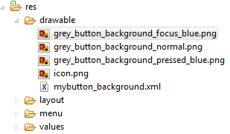
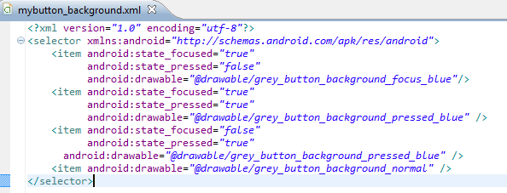
Drawable Selector
http://www.gersic.com/blog.php?id=56

Slide 28
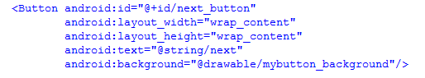
Apply to Button
http://www.gersic.com/blog.php?id=56

Slide 29
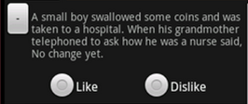
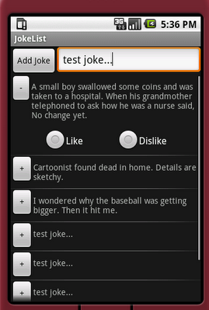
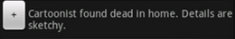

Future: ListView
Layout: JokeView.xml

Slide 30
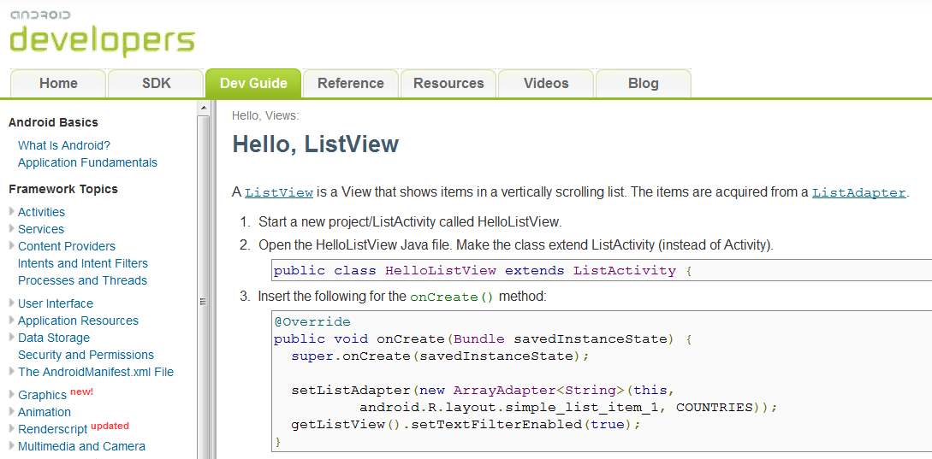
For now: simple ListView
http://developer.android.com/guide/tutorials/views/hello-listview.html

Slide 31
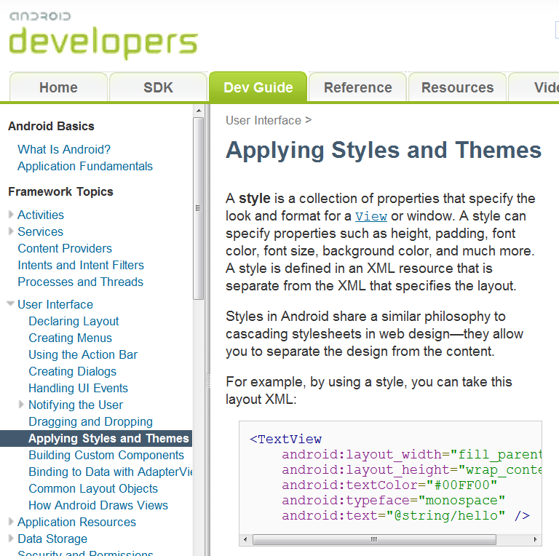
Further Reading
http://developer.android.com/guide/topics/ui/themes.html

Slide 32


HAPPY
Dr id!

Slide 33
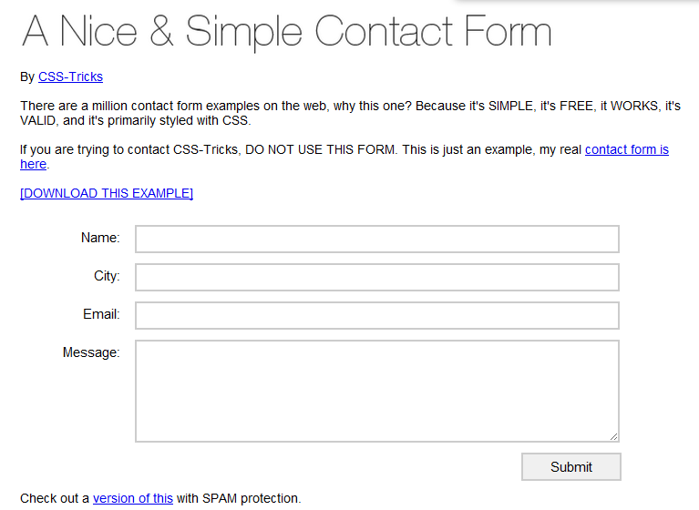
http://css-tricks.com/examples/NiceSimpleContactForm/

Slide 34
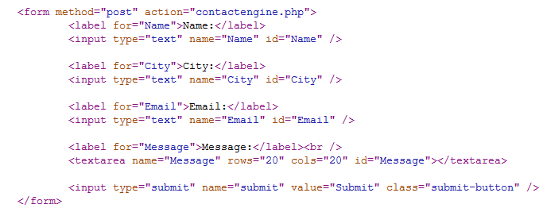
HTML form example:

Slide 35
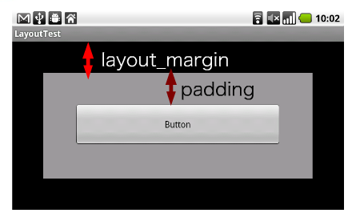
Margin vs padding
http://www.slideshare.net/yanzm/head-first-xml-layout-on-android-5290462

Slide 36
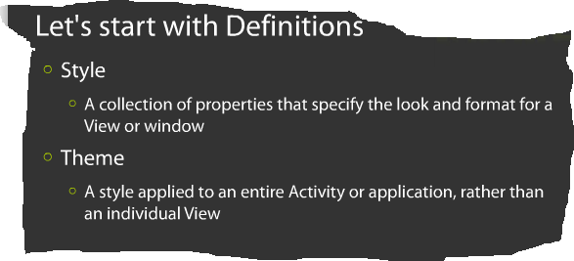
http://www.slideshare.net/pavelpetrek/google-developer-day-2010-prague-styles-in-android

